Slide 1
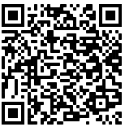
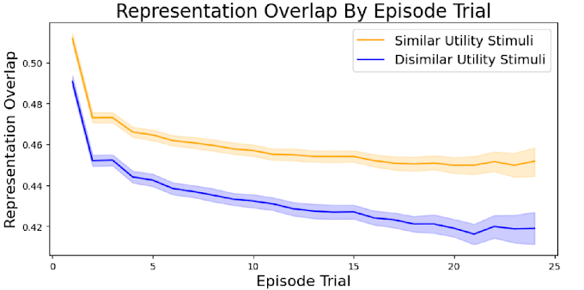
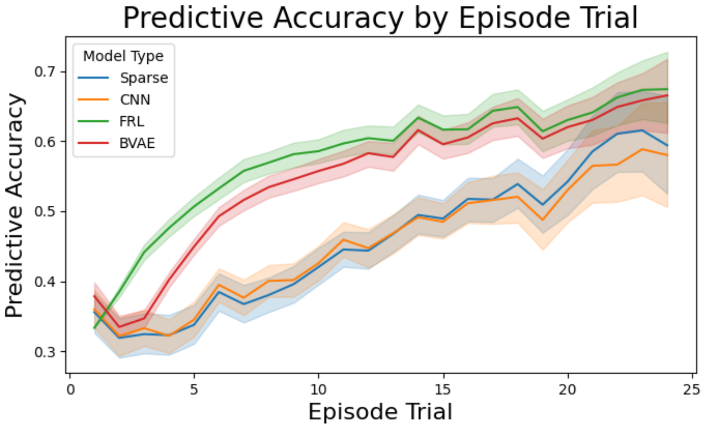
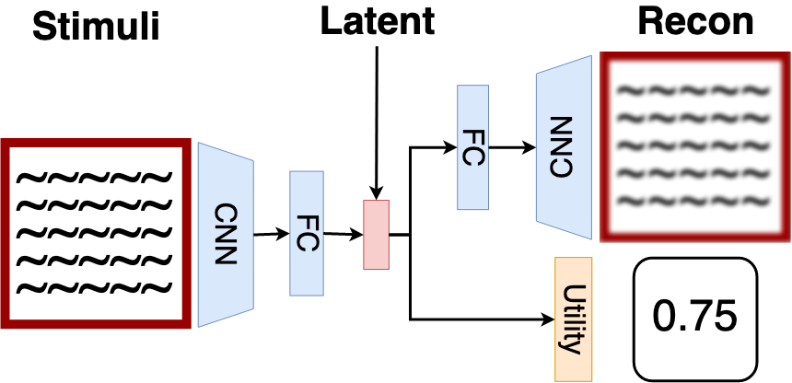
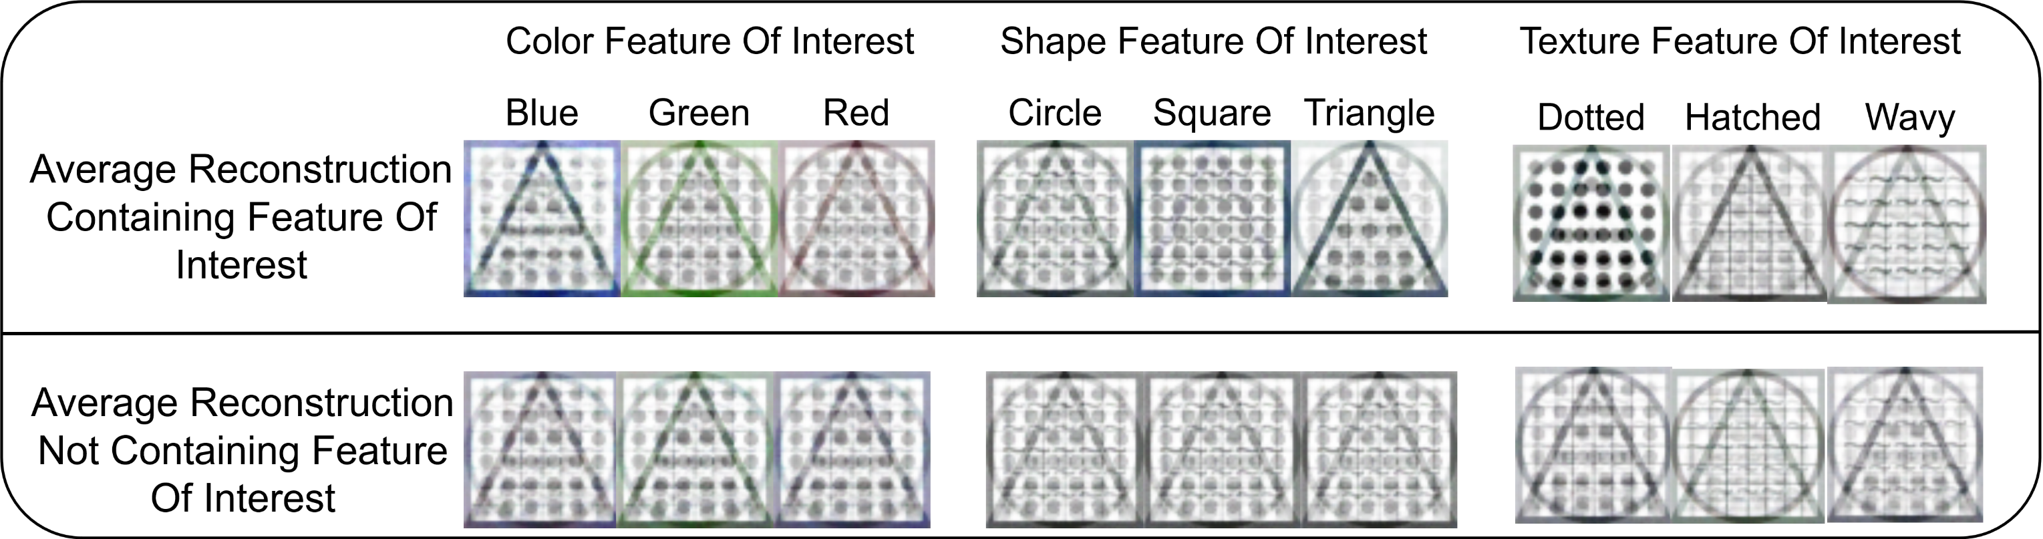


Representations of visual information used in learning can be modelled with a disentanglement objective. This model describes how learning stimuli utility changes visual representation formation strategy.
Abstract
Abstract
Abstract
β Variational Autoencoders (β-VAE) form representations of visual information by maximizing the disentanglement objective. As stimuli deviate along a single dimension, so do these representations. Deep reinforcement learning (DRL) can be difficult to apply onto predicting human behaviour. This model addresses this by using representations of stimuli in learning tasks produced by a combined DRL and β-VAE model:
We apply the described model onto predicting human behaviour in a contextual bandit learning task. The model has a higher accuracy than alternative DRL models using traditional Convolutional Neural Networks or a sparse CNN model that mimics the information bottleneck of β-VAEs.
Measuring β-VAE representation overlap gives insight into how changing utility impacts learned visual representations.
Reconstructing noisy latent samples demonstrates that high-utility representations are more resilient to noise and take up more of the latent representation space.
Reconstruction Accuracy
Utility Accuracy
The tabular Feature RL method provides utility predictions to the three deep neural network methods. This FRL model takes as input hand-crafted features instead of visual information.
Latent Representation Complexity
Conclusion
Modelling Human Reinforcement Learning with Disentangled Representations
The disentanglement objective learned by β-VAE models describes how learning utility impacts visual representation formation, while also predicting behaviour. This suggests a source of acquired equivalence of visual information based on representation overlap. Future research comparing how participants detect change can further apply this model.
Tyler Malloy, Tim Klinger, Chris R. Sims

